Slide 1




NEXT GEN EMPLOYABILITY PROGRAM
Creating a future-ready workforce
Team Members
College Name
Student Name :DINESHKUMAR S
Student ID : au513521104012
Annai Mira College of Engineering and Technology

Slide 2

CAPSTONE PROJECT SHOWCASE
Project Title
Building Bus Reservation System using Python and Django
Abstract | Problem Statement | Project Overview | Proposed Solution | Technology Used | Modelling & Results | Conclusion

Slide 3
Abstract
Purpose: The project aims to develop a web-based platform that allows users to easily search for available bus routes, select seats, and make reservations online, providing a convenient and efficient way to plan and book bus travel.
Features: The system will include features such as user authentication, bus management (including routes, schedules, and availability), a reservation system with seat selection and also cancelling the booked buses.
Technology Stack: Built using Python and the Django web framework, the project utilizes Django’s built-in authentication system for user management, and integration with third-party payment gateways for secure transactions.
Objective: By creating an intuitive and user-friendly interface, the project aims to streamline the bus reservation process, enhancing the overall experience for both passengers and bus operators while providing a robust and scalable solution for managing bus reservations online.

Slide 4
Problem Statement
Inefficient Booking Process: Currently, there is a lack of efficient and user-friendly platforms for booking bus tickets online. Existing systems may suffer from complicated interfaces, limited availability information, or lack of integration with payment gateways, leading to frustration and inconvenience for users.
Manual Management for Bus Operators: Bus operators often rely on manual processes for managing routes, schedules, and reservations, leading to inefficiencies, errors, and difficulties in maintaining up-to-date information. There is a need for a centralized, automated system that enables bus operators to efficiently manage their services and improve overall operations.
Lack of Real-Time Updates: Users may face challenges in obtaining real-time updates on bus availability, schedules, and reservations, resulting in uncertainty and inconvenience when planning their travel. A solution is required to provide accurate and timely information to users, enhancing their experience and facilitating smoother travel planning.

Slide 5
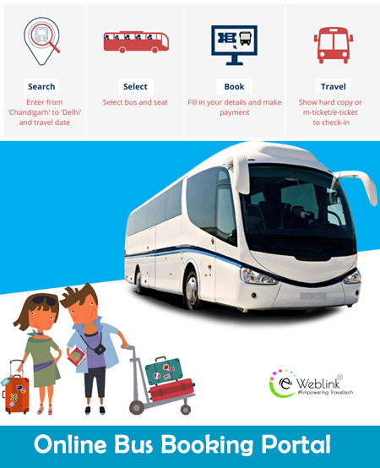
Project Overview
Booking Buses Made Easy: We're creating a website where you can easily find and book bus tickets online. No more standing in long lines or struggling with confusing websites. Just a few clicks, and you're all set for your journey!
Hassle-Free Travel Planning: Our platform will let you check bus routes, pick your seats, and pay securely online. Say goodbye to last-minute worries about finding a seat or missing out on your preferred bus – we've got you covered!
Convenient for Bus Operators Too: Bus operators will have an easy time managing their services with our system. They can update schedules, track bookings, and keep everything running smoothly, making travel hassle-free for everyone involved.

Slide 6
Proposed Solution
Our Project provides the solution to the problems in Bus Ticket Booking in a simplified and efficient way . Our websitet contains the following features that will make the Bus Booking process very easier
User-Friendly Interface: Develop a clean and intuitive user interface for the website, allowing users to easily search for bus routes, view available schedules, and select seats based on their preferences. The interface should be responsive and accessible across different devices.
Comprehensive Bus Database: Create a comprehensive database to store information about buses, routes, schedules, seat availability, and pricing. This database will serve as the backbone of the system, enabling efficient retrieval and management of data.
User Authentication and Profiles: Implement a user authentication system to allow users to create accounts, log in securely, and manage their profiles. Users should be able to view their booking history, update personal information, and manage preferences.

Slide 7
Bus Management Dashboard: Provide bus operators with a dedicated dashboard to manage their services. This dashboard will allow operators to add new buses, update routes and schedules, manage seat availability, and track bookings in real-time.
Dynamic Seat Selection: Implement a dynamic seat selection feature that allows users to view and select available seats on the bus. Users should be able to see which seats are already booked and choose their preferred seating arrangement.
Real-Time Availability Updates: Ensure that seat availability information is updated in real-time to provide users with accurate and up-to-date information. This will prevent overbooking and reduce the likelihood of conflicts during the reservation process.
Secure Payment Integration: Integrate a secure payment gateway to facilitate online transactions for bus reservations. Users should be able to pay using various payment methods, such as credit/debit cards, mobile wallets, or net banking, with confidence in the security of their personal and financial information.

Slide 8
Email Notifications: Set up automated email notifications to confirm bookings, provide booking details, and send reminders about upcoming trips. These notifications will enhance the user experience and keep users informed throughout the reservation process.
Feedback and Support: Include features for users to provide feedback on their booking experience and seek support in case of any issues or concerns. This will help in continuously improving the platform and addressing any customer inquiries promptly.
Scalability and Performance: Design the system with scalability and performance in mind to handle a large number of concurrent users and accommodate future growth. Utilize caching mechanisms, optimize database queries, and employ scalable infrastructure to ensure smooth operation even during peak usage periods.
These features of our website solve the problems in the Bus Ticket Booking process and makes the process more easy and efficient .

Slide 9


Technology Used
Front-end
Back-end

Slide 10
Modelling & Results
MODELLING:
Database Modeling: Utilize Django's ORM to design and implement the database schema for the project. Define models for buses, routes, schedules, reservations, users, and any other relevant entities. Establish appropriate relationships between these models (such as one-to-many or many-to-many) to accurately represent the data structure.
User Interaction Modeling: Model the user interaction flow through wireframes or mockups to visualize the user interface design. Consider the user journey from searching for bus routes to making a reservation and receiving confirmation. Iterate on the designs based on usability testing and feedback to optimize the user experience.
RESULTS:
User satisfaction on using our website .
Easier way of booking the tickets in the easier and in the efficient way
Source :

Slide 11
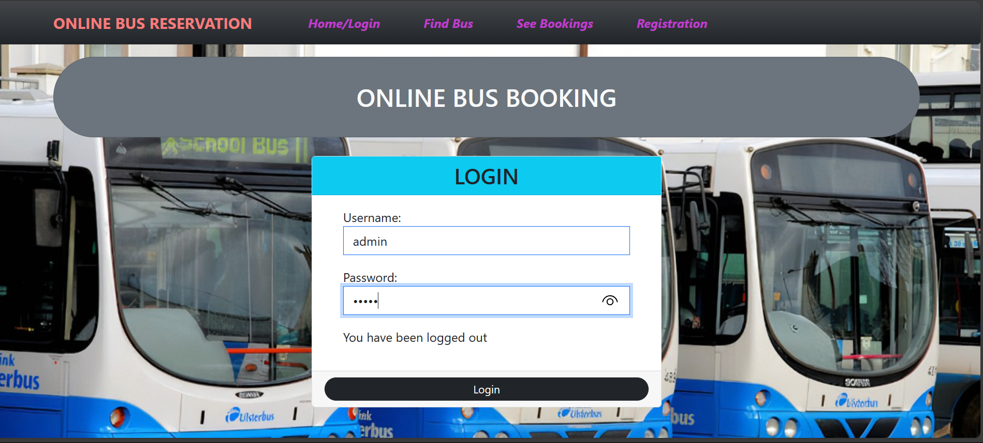
Homepage

Slide 12
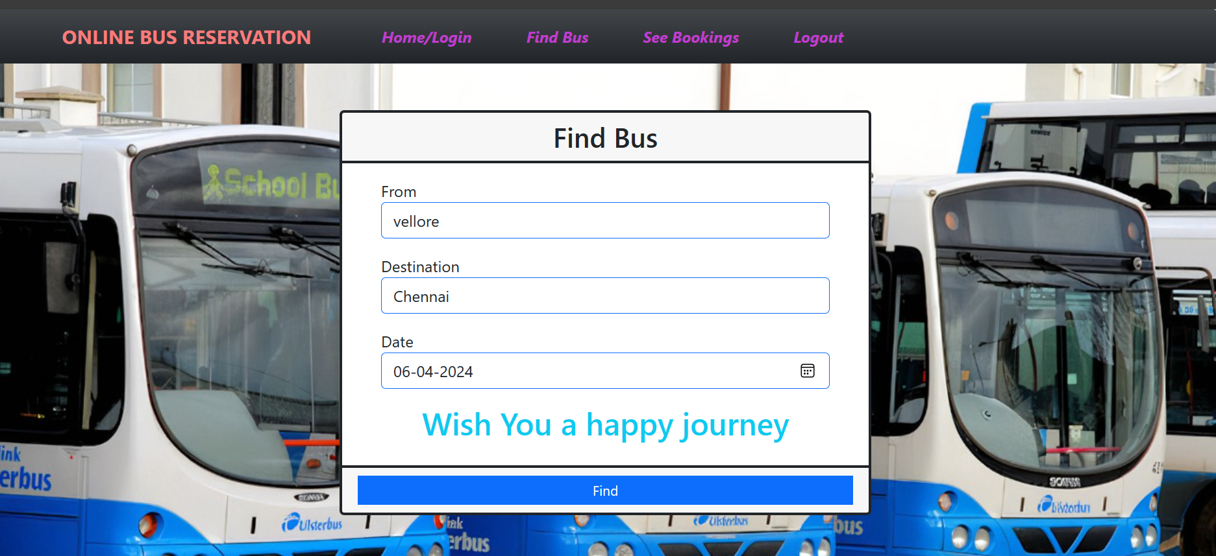
Find Bus Page

Slide 13
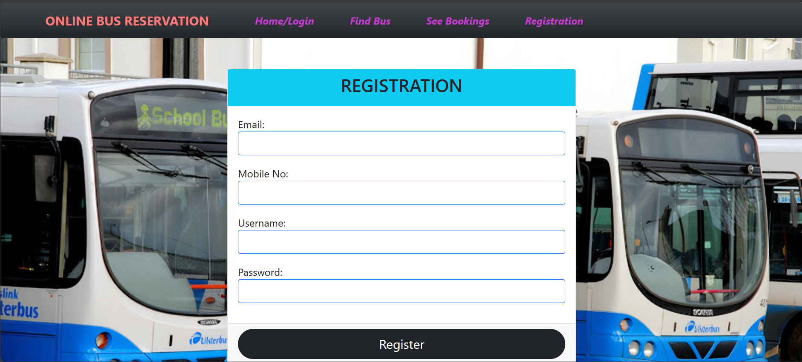
Registration page

Slide 14
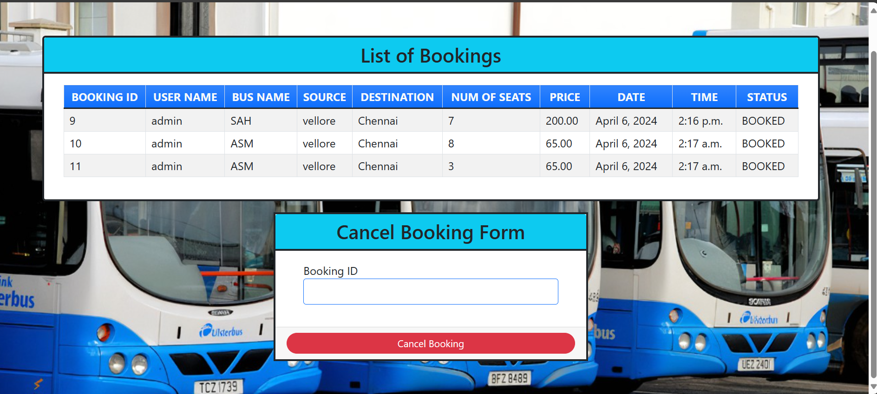
List of Bookings Page

Slide 15
Future Enhancements:
Mobile App Development: Consider developing a mobile app version of the online bus reservation platform to cater to users who prefer to book tickets and manage reservations on their smartphones or tablets. The app could offer additional features such as push notifications for booking updates, GPS tracking of buses in real-time, and seamless integration with mobile payment options for enhanced convenience and accessibility.
Advanced Analytics and Personalization: Implement advanced analytics and machine learning algorithms to analyze user behavior, preferences, and booking patterns. Use this data to personalize the user experience by offering targeted recommendations, customized promotions, and tailored travel suggestions based on individual preferences and past booking history. This could help increase user engagement, loyalty, and conversion rates on the platform.
Integration with Transportation Networks: Explore opportunities to integrate the online bus reservation platform with other transportation networks, such as railways, airlines, and ride-sharing services. This could enable users to seamlessly plan multi-modal journeys, book connecting tickets, and access integrated travel itineraries through a single platform.

Slide 16
Conclusion
Achievements and Milestones: Reflect on the achievements and milestones reached throughout the project development lifecycle. Highlight key accomplishments, such as the successful implementation of core features, integration with payment gateways, and deployment to a production environment.
User Feedback and Impact: Discuss the feedback received from users during beta testing or post-launch surveys. Summarize the overall user experience and satisfaction with the platform, including any areas for improvement identified by users. Additionally, analyze the impact of the project on facilitating convenient and efficient bus travel booking for users.
Lessons Learned and Future Directions: Share insights gained from the project, including challenges faced, lessons learned, and best practices identified. Reflect on areas where improvements could be made in future projects or iterations. Discuss potential future directions for the platform, such as additional features, expansions into new markets, or integration with other travel services.

Slide 17
Thank You!
Notes:
Thank You !!

